Slide 1
Genetics
LS 1201

Slide 2
Which is the most important discovery in biological sciences?
Compound Microscope

Slide 3
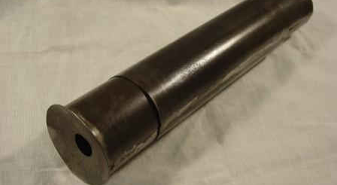
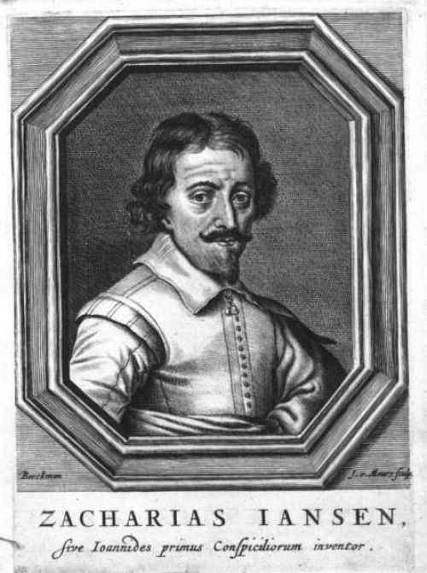
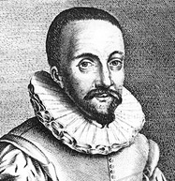
Invention of First Compound Microscope
First compound microscope (1590)
Hans Lippershey, (1570)

Slide 4
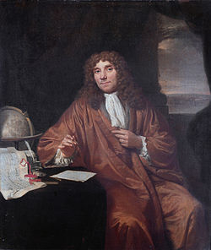
Timeline of Scientific Discoveries
Best known for his work on the improvement of the microscope & for establishment of microbiology.
Father of Microbiology
(1632–1723)
1675 – Anton van Leeuwenhoek:
Observes Microorganisms by Microscope
Ref Google images

Slide 5
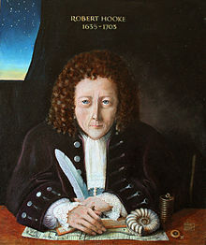
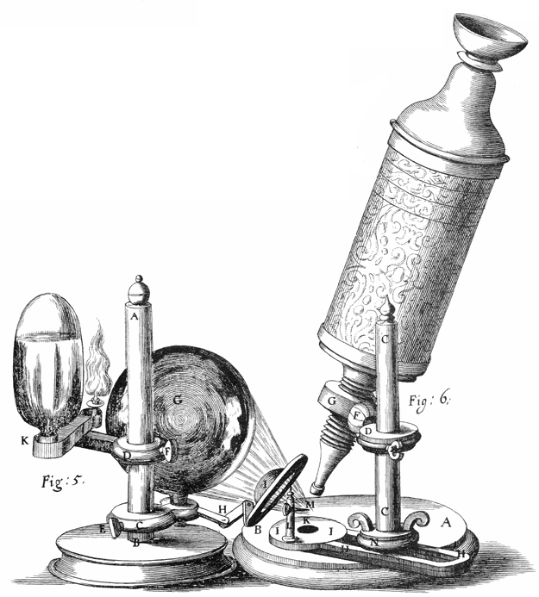
Timeline of Scientific Discoveries
1665: Robert Hooke discovers cells in cork, then in living plant tissue using an early compound microscope. He coins the term cell
Ref Google images

Slide 6
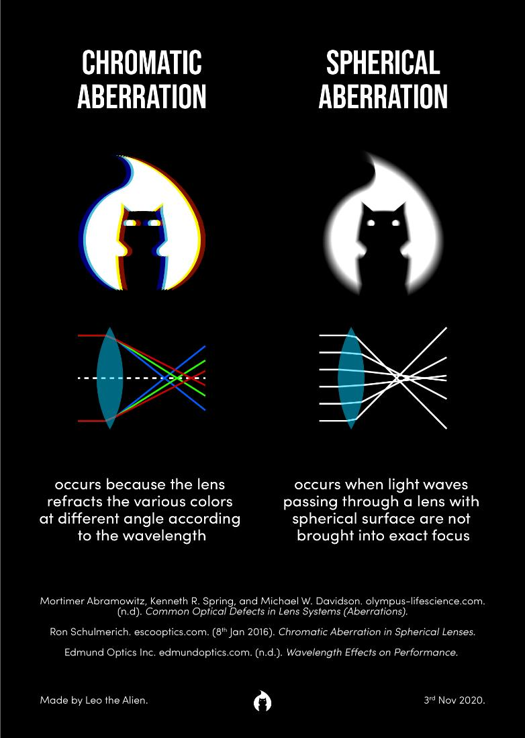
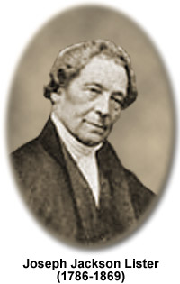
Limitations of Earlier Microscopes
Spherical aberration : Image blurring
Chromatic aberration: Colour separation
Resolved by Joseph Jackson in 1830

Slide 7
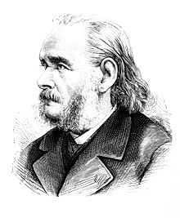
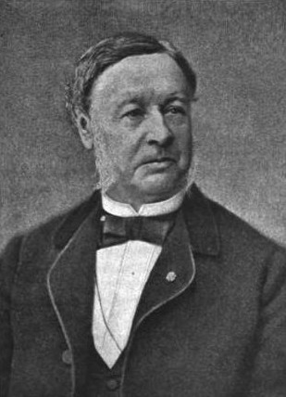
Cell Theory -1838
Theodor Schwann (1810 –1882)
Matthias Jakob Schleiden (1804–1881)
1. All living organisms are composed of one or more cells
2. The cell is the most basic unit of life

Slide 8
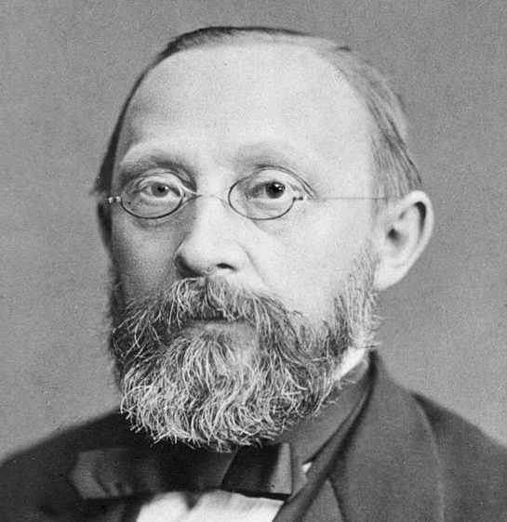
Rudolf Virchow -1855 (Omnis cellula e cellula)
“cells can only arise from
pre-existing cells”
Virchow observed abnormal increase in white blood cells in patients named it leukämie in 1847
Virchow was the first to correctly link the origin of cancers from otherwise normal cells
(1821 –1902)

Slide 9
1858 – Rudolf Virchow: cells can only arise from pre-existing cells
1861 - Louis Pasteur: Germ theory
1865 – Gregor Mendel: Mendel's laws of inheritance, basis for genetics

Slide 10
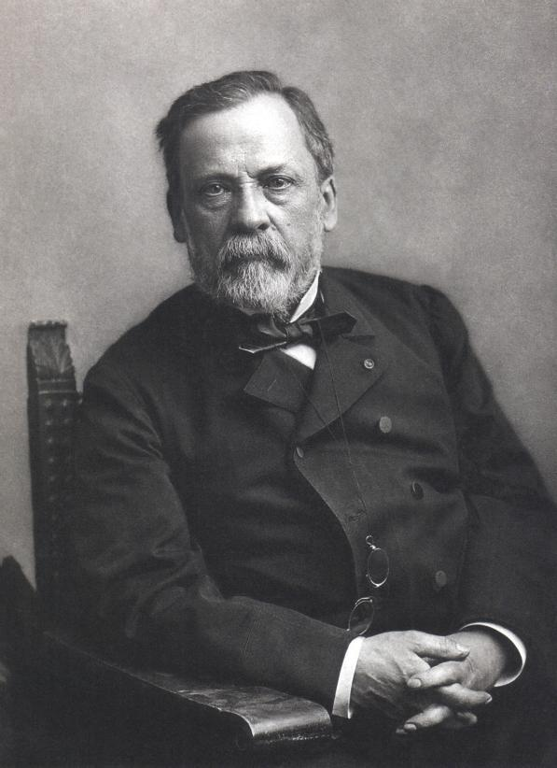
Louis Pasteur: Germ Theory of Diseases (1861)
French chemist and microbiologist
principles of vaccination,
microbial fermentation
pasteurization
Louis Pasteur (1822-1895)
Ref Google images

Slide 11
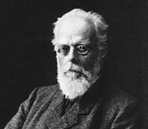
Germ Plasm Theory:
inheritance only takes place by means of the germ cells—the gametes such as egg cells and sperm cells. Other cells of the body—somatic cells—do not function as agents of heredity.
August Weismann
(1834 –1914)

Slide 12
Discovery of Mitosis (1875) and Meiosis (1886)
1892- Weismann : Theory of germ plasm (German biologist)
1944 – (Oswald Avery, McCarty & Macleod) : proves that DNA is the genetic material of the chromosome
1953 – Crick and Watson: helical structure of DNA, basis for molecular biology

Slide 13
Pre Mendelian Era
Theories
1. Vapour Fluid Theories
2. Preformation Theories
3. Particulate Theories

Slide 14
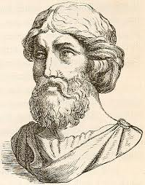
VAPOUR AND FLUID THEORIES
PYTHAGORAS(500BC)
proposed that every organ of animal body gives out some type of vapours . These vapours unite and form a new individual.

Slide 15
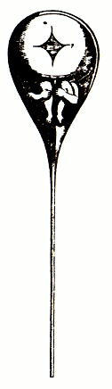
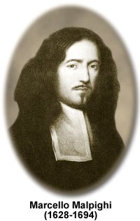
Preformation Theory
Preformation (Marcello Malphigi, 1672)
Ref- wikipedia
Preformed human in sperm

Slide 16
PARTICULATE THEORIES
1) Inheritance of acquired characters
(Lamarkism)
2)Theory of Pangenesis,
3) Blending inheritance
4) Laws of inheritance ( Mendel)

Slide 17
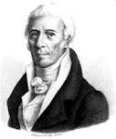
INHERITANCE OF ACQUIRED CHARACTERS
LAMARCK (1744-1829)
in 1809 proposed the phenomenon of “inheritance of acquired characters” among living organisms.
But he failed to provide convincing evidences in support of his concepts.

Slide 18
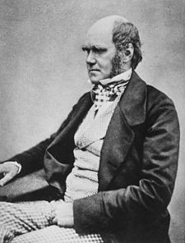
Theory of Pangenesis
CHARLES DARWIN (1868)
According to it each part of the animal body produces many minute particles known as gemmules ,which are first collected in the blood and then concentrated in the reproductive organs.
When the animal reproduces into new individual, these gemmules pass on to it and it has blending of both parents.

Slide 19
Blending inheritance
Blending Inheritance:
Individuals inherit a smooth blend of traits from their parents.
Example: The height of a person, with one short parent and one tall parent, was thought to always be of some interim value between its two parents' heights.
Limitations:
the potential for variation would tend to narrow, quite dramatically, with each generation
It failed to explain how traits that seemingly disappeared for several generations often reasserted themselves down the line, unaltered.

Slide 20
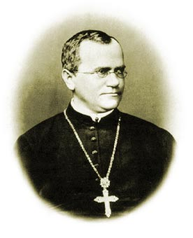
Brief History of Genetics
*Gregor Mendel (1866)
Particulate Inheritance
Gregor Mendel – Father of genetics

Slide 21
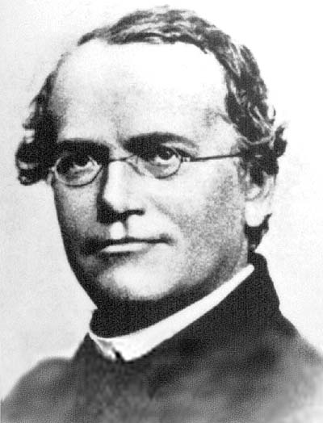
Mendelian Genetics
Gregor Mendel (1822-1884)
Father of Genetics
Traits are composed of combinations of distinct alleles rather than a continuous blend

Slide 22
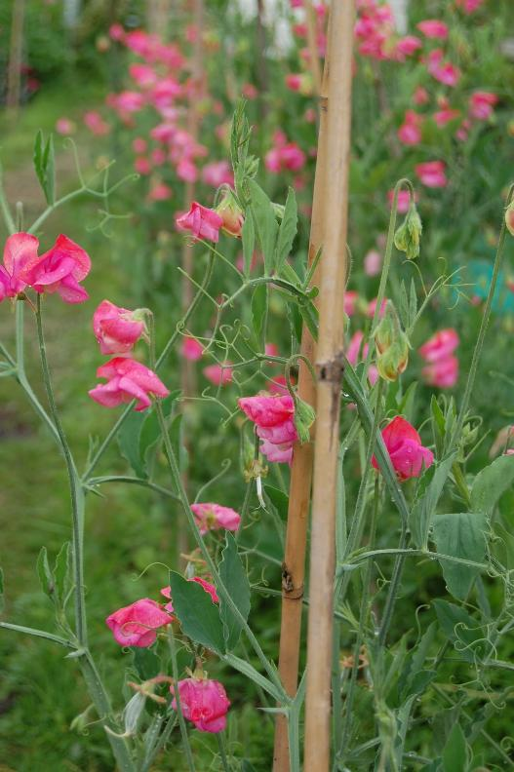
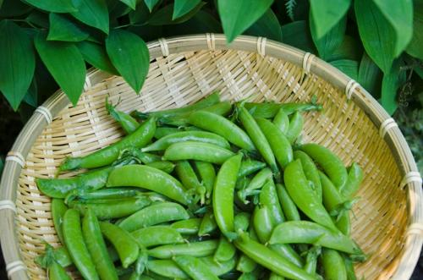
What did Mendel work on?
Pea Plant

Slide 23
Reasons for Mendel’s Success
Good scientific technique.
Chose right research material well suited to the study of the problem at hand
Designed his experiments carefully, collected large amounts of data, and used mathematical analysis to show that the results were consistent with his explanatory hypothesis..
Some amount of Luck!!

Slide 24
What is Genetics?
Ancient Greek '''genesis” meaning "origin"
Genetics is a discipline of biology, that deals with science of genes, heredity, and variation in living organisms.
It deals with the following aspect of genes
Molecular structure & function
Behavior (Dominant or recessive)
Pattern of Inheritance
Variation in the population

Slide 25
Application of Genetics
Food Production (green revolution)
Diagnosis of human diseases
Mass production of enzymes, hormones & proteins

Slide 26
Application of genetics in criminal law

Slide 27
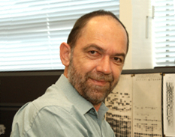
DNA finger printing
DNA fingerprinting was developed in
1984 by Alec. J. Jeffrey at the
University of Leicester
On some human chromosomes, a short sequence of DNA has been repeated a number of times like (GATA)_{n} or (CACATTA) _{n}
Exploits the difference in the number of tandem repeats between individuals.
Sir Alec. J. Jeffrey

Slide 28

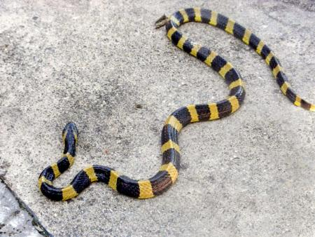
DNA fingerprinting in India
Banded Krait
(Bungarus fasciatus)
Dr Lalji Singh
‘(1947- 10th Dec 2017)

Slide 29

DNA Fingerprinting

Slide 30
Paternity test
mother
father
child
Child will receive one copy of the repeat fragment from the
mother and one from the father. It could be any one of these
combinations
Notes:
The vertical lines should not be confused with chromosomes. They each represent lengths of double-stranded DNA in a single chromosome

Slide 31
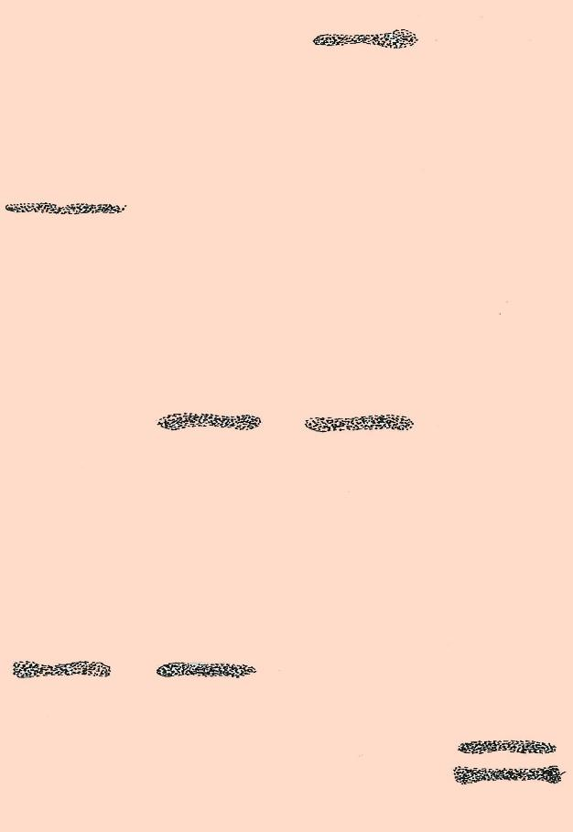
Paternity test
Genetic fingerprint of …
1 mother
2 child
3 possible father A
4 possible father B
There is a match between one of
the child’s repeat fragments
and one of the mother’s.
There is also a match between the child’s other fragment and one from possible father A.
Neither of the child’s repeat
fragments match those of possible
father B
1
2
3
4
Starting position of sample

Slide 32
How Genetics has impacted human life?
Food production:
Green revolution- Dramatic increase in the yield of crop plants to feed the over populated world
Human health:
thousands of genes involved in growth, differentiation and maintenance. Ex. Phenylketonuria (mutant enzyme is phenylalanine hydroxylase)
Criminal Law:
DNA finger printing

Slide 33
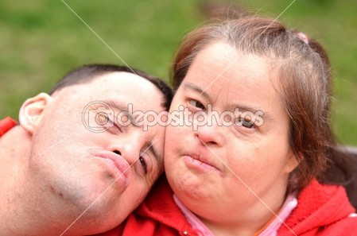
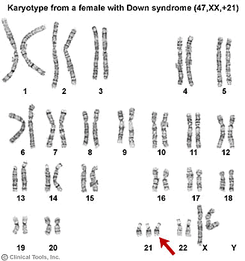
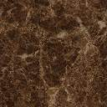
Genotype Vs Phenotype
What is a Phenotype?
The way an organism
looks like
What is a Genotype?
All the genes an
organism carries.

Slide 34
How do you get a phenotype?
The phenotype of each organism is controlled by it’s genotype.
BUT
Environment also plays an important role

Slide 35
Genotype + Environment
Phenotype

Slide 36
Some more Examples!!
Genotype + Environment
Phenotype

Slide 37
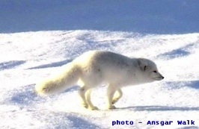
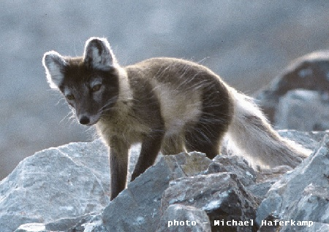
Arctic Fox: Effect of Temperature
Coat color in Summer
Coat color in Winter

Slide 38
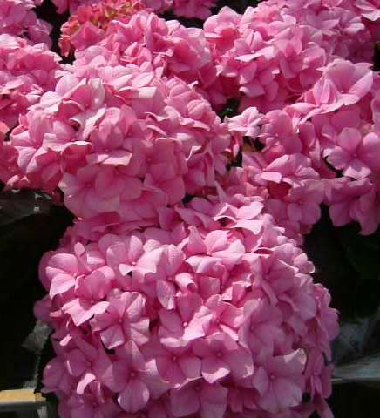
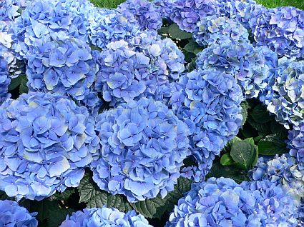
pH of soil regulating flower color in hydrangea plant
acidic
alkaline

Slide 39
Let’s look at an example where environment caused a permanent change!!

Slide 40
Industrial Melanism
What is Melanism?
The occurrence of an increased amount of dark pigmentation (melanin) (skin, feathers, eyes or hair) in an organism
Why do we call it industrial?
Industrialization resulted in alteration of natural enviroment in terms of industrial pollution

Slide 41
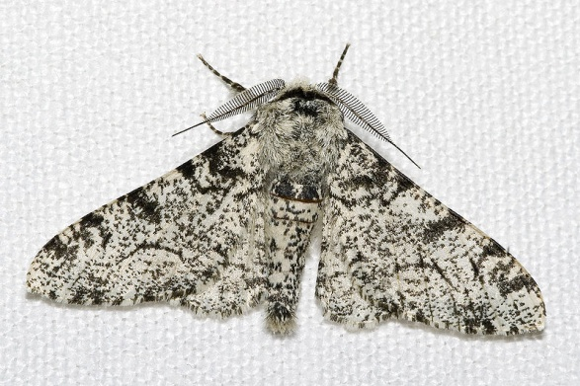
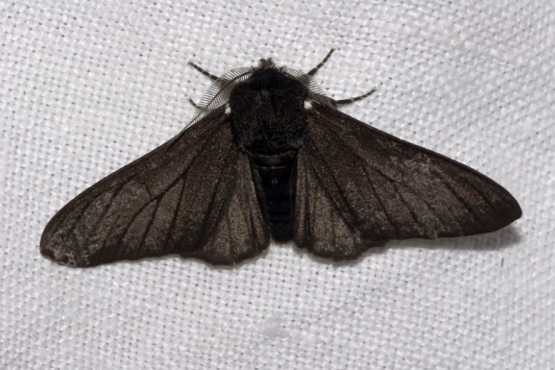
Peppered Moth Evolution by H.B.D. Kettlewell
Biston betularia f.carbonaria
Biston betularia f.typica
Survived well on the tree trunks in rural areas
Survived well on the tree trunks in urban areas

Slide 42
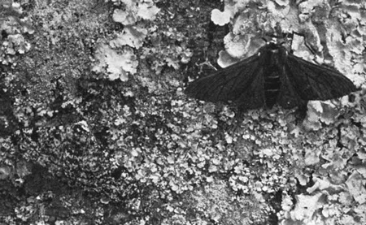
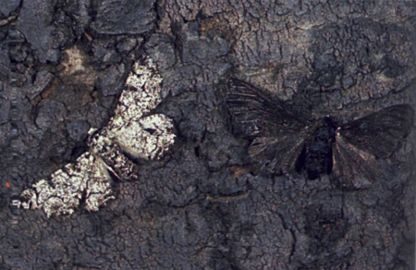
Hypothesis:
Originally, the majority of peppered moths had light colouration, which effectively camouflaged them against the light-coloured trees and lichens which they rested upon
Urban Area
Rural Area

Slide 43
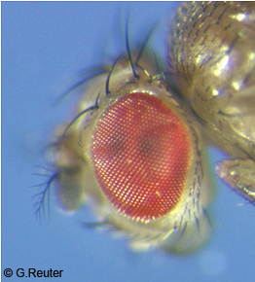
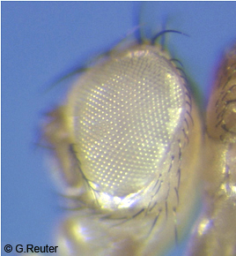
Wild type Vs Mutant
Wild type (or wildtype abbreviated wt) refers to the phenotype of the typical form of a species as it occurs in nature.
Large number in the population.
A mutant is an individual, organism that exhibits a new character or trait not found in the wild type.
Less frequent in the population
In genetics, the wild-type organisms serve as the original parent strain before a deliberate mutation is introduced (for research) so that geneticists can use them as reference to compare the naturally occurring genotypes and phenotypes of a given species against those of the deliberately mutated counterparts.

Slide 44
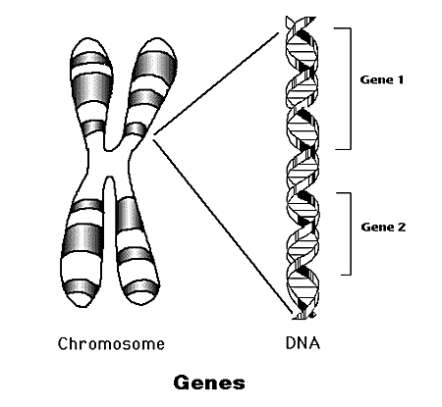
Genetic Information
Genome – the collection of genetic information.
Chromosomes – storage units of genes.
Gene – basic unit of genetic information. Genes determine the inherited characters.
DNA - is a nucleic acid that contains the genetic instructions specifying the biological development of all cellular forms of life
http://www.accessexcellence.com/AB/GG/

Slide 45
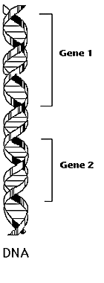
Chromosome Logical Structure
Locus – location of a gene/marker on the chromosome.
Allele –variants of a gene/marker at a particular locus.
Locus1
Possible Alleles: A1,A2
Locus2
Possible Alleles: B1,B2,B3

Slide 46
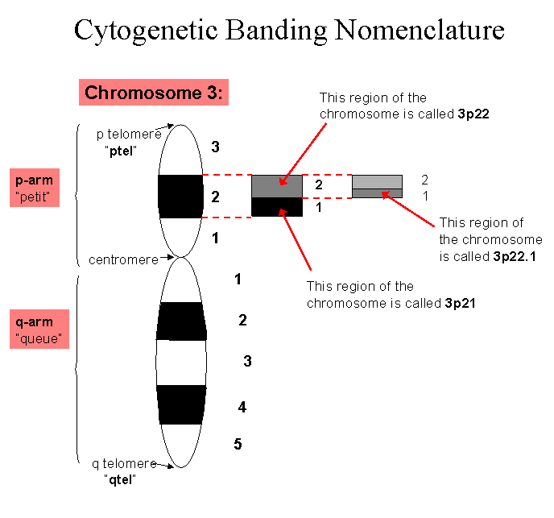
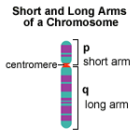
Genetic Locus
A locus (plural loci) is the specific location of a gene, DNA sequence, or position on a chromosome

Slide 47
What is an Allele ?
An allele is different forms of the DNA sequence of a particular gene. (variants of a gene)

Slide 48
Example of Alleles : ABO system
ABO gene encodes an enzyme glycosyl transferase. (Chromosome 9)
Modifies the oligosaccharide on cell surface glycoprotein
A allele adds N-acetyl galactosamine
B allele adds galactose
o allele is deletion which lacks the glycosyl transferase activity.

Slide 49
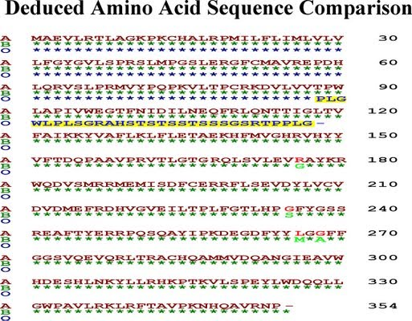
ABO allele

Slide 50
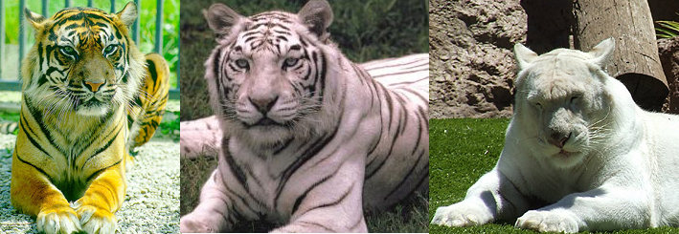
Wildtype and mutant allele
The allele that encodes the phenotype most common in a
particular natural population is known as the wild type allele.
It is often designated, in genetic shorthand, as "+” or WT
Any form of an allele other than the wild type is known as a mutant form of that allele.
Wildtype / +
white tiger
albino tiger

Slide 51
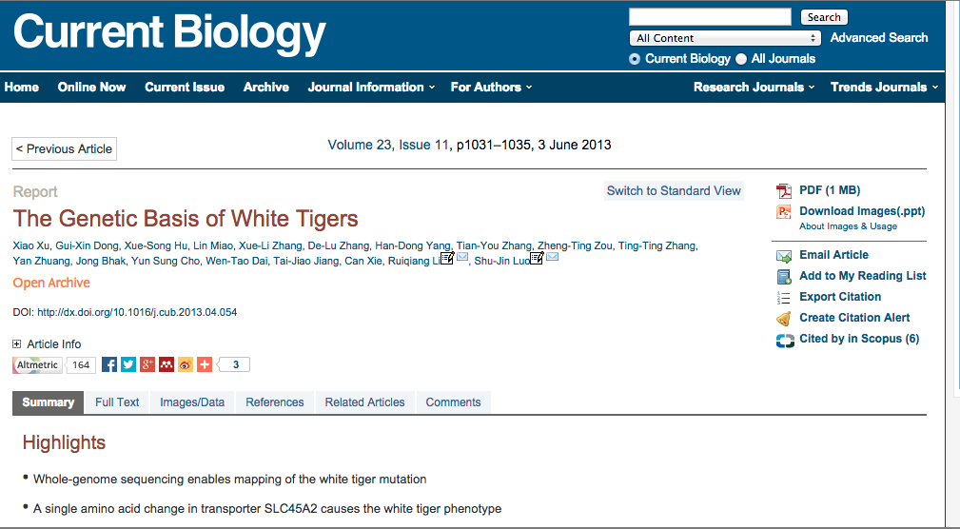
The gene variant found in the white tiger primarily inhibits the synthesis of red and yellow pigments but has little to no effect on black, which explains why white tigers still show characteristic dark stripes.

Slide 52
Differences between Gene & Allele
Genes are something we inherit from our parents. While Alleles determine how they are expressed in an individual.
Alleles occur in pairs but there is no such pairing for genes.
Alleles determine the traits we inherit.
The genes we inherit are the same for all humans. However, how these manifest themselves is actually determined by alleles!

Slide 53
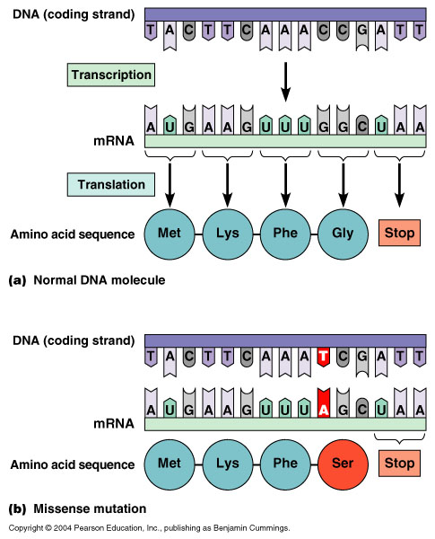
GENE
Allele

Slide 54
Symbols And Terminology
Wild type- For a given pair of alternate trait that is more frequent in a population (+/+)
Mutant- Alternate form of trait rare in natural population.
i) Dominant Allele: Upper case letter (A)
ii) Recessive Allele: Lower case letter (a)

Slide 55
Exercise
How will you determine if a trait is dominant or recessive in a population?

